Slide 1
SWEN90016 Software Processes and Management
Tutorial 07 – Configuration Management, Version Control
- Rahul Sharma <sharma1@student.unimelb.edu.au>
Notes:
Lecture 9 and 10

Slide 2
Today’s aim
Become familiar with
GIT
and octocat

Slide 3
So what is Git?
Version Control System
Made by Linus Torvalds! (developer of the Linux kernel)
Notes:
a mature software development environment has the following processes:
- code sharing
- code backup
- roll-back
- parallel branching

Slide 4
Git Advantages
Distributed (everyone has their own code repository local to them!)
Open Source (everyone likes open source code :) )
Notes:
Distributed is fast, no network bottle necks
Distributed is bomb proof
http://thehackernews.com/2015/03/github-hit-by-massive-ddos-attack-from_27.html
attack specifically targets two popular Github projects – GreatFire and CN-NYTimes – anti-censorship tools used to help Chinese citizens circumvent The Great Firewall Of China, the government's censorship of Internet access in China.
Open sourced code evolves quickly

Slide 5
General Git Workflow
git init
git add filename
git commit -m “message”
git push
Initialize local repository called master
Track changes made to the contents of this file
Save this file in local repository
Save this collection
- to remote repository called origin
- from local repository called master
Notes:
Initially use the KISS principle: Keep It Simple Stupid

Slide 6
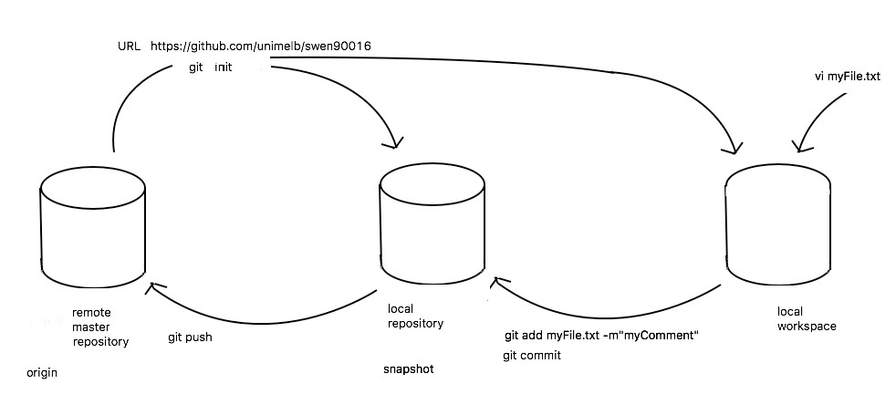
Git Round Trip
init
push
add, commit
Notes:
Simple visual round trip

Slide 7
git init
What does it do: Initializes an empty Git repository locally
Its empty!
Notes:
This command turns a plain vanilla directory in the file system into a directory with a newly created, local, empty git repository.
- basically a .git directory with subdirectories for objects, git references such as head pointer, and tag labels, and template files.
A default (local) master branch is also created.

Slide 8
git clone
its not empty!
What does it do:
Initializes an empty local repository
fetches code from the remote repository into your local repository
git pull remote_repository_URL
What does it do: fetches code from the remote repository into your local repository
Notes:
Don’t need to do “git pull”, as git clone does it under the hood

Slide 9
Git Concept: Clone
What does it do:
Initializes an empty Git repository locally, and
fetches code from the remote Git repository into your local repository
similar to svn checkout but you get the whole copy, a lot of history, and can take a while
Example command:
git clone https://github.com/tiow/swen90016_workshop05
Notes:
Shortcut, used often.

Slide 10
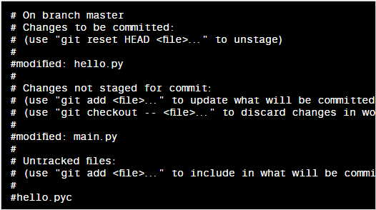
Git Concept: Status
What does it do: Shows you the status of your local repository
shows files to be added, modified and untracked files as well.
Example command:
git status

Slide 11
Git Concept: Add / Remove
Adds or removes a file from your workspace to your local repository
Files in local repository are called “staged”
Staged files have their contents monitored
Example command:
git add filename OR git rm filename

Slide 12
Git Concept: Commit
What does it do: This saves your changes to the local repository.
Example command:
git commit -m “some message!”
Notes:
Safety of code form accidental deletion
Can roll back from here.

Slide 13
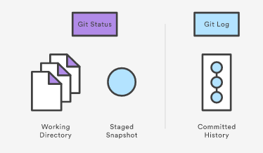
Git Concept: Log
What does it do: Shows the history of commits into the system.
Example command:
git log
Notes:
Do this before push to remote repo

Slide 14
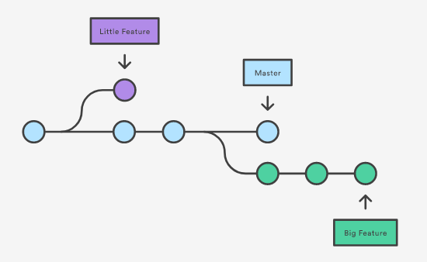
Git Concept: Branching
Notes:
Parallel development

Slide 15
Exercise: learn git online
Access git tutorial online from: https://try.github.io
Now type git commands:
git init
git status

Slide 16
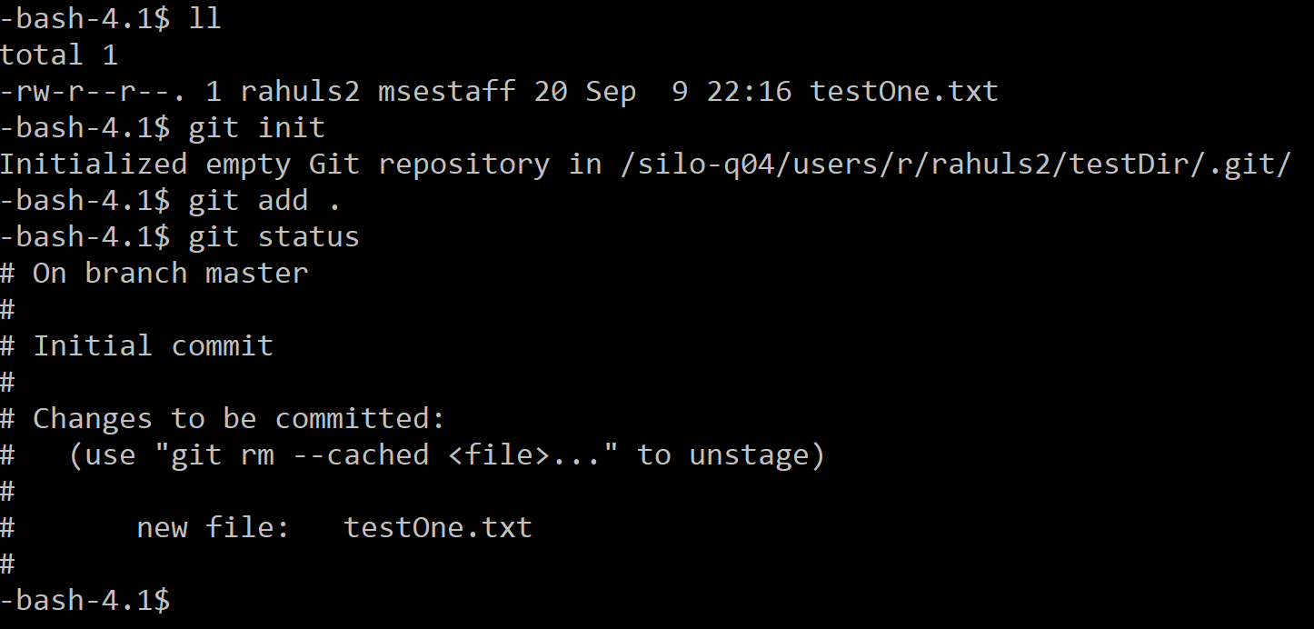
git add octocat.txt
This will stage all the files in the current directory. Type:
git status
This will show the staging area.
git commit –m “my first commit”
git log
This will show the current logs of all your commit.

Slide 17
Find the new, empty GitHub remote repository, with the following URL
git remote add origin https://github.com/try-git/try-git.git
and
Push our local repo to the remote GitHub server repository
git push –u origin master
Notes:
Round trip

Slide 18
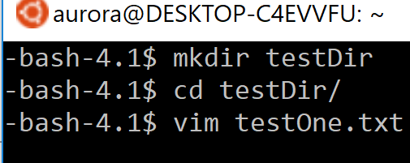
Access git on the UniMelb server
Use any SSH client (PuTTY/ MobaXterm/ Terminal/ Bitvise) to ssh into Uni server
Login: ssh <your LMS Username>@swenshare.cis.unimelb.edu.au
Once you have access, try the following commands:
mkdir testDir
cd testDir
Create a file:
vim testOne.txt
Notes:
Type some content into the vim editor using insertion mode (press ‘i’) and after you are done, press Esc. Then type :wq and hit enter.

Slide 19
Type some content into the vim editor using insertion mode (press ‘i’) and after you are done, press Esc. Then type :wq and hit enter.
Now type:
ll (LL CAPITALISED)
This will show you the contents of the directory where you should be able to see testOne.txt present.
Now type:
git init

Slide 20
git add .
This will stage all the files in the current directory. Type:
git status
This will show the status of the files.
git commit –m “My First Commit”
git log
This will show the current logs of all your commit.

Slide 21
vim testOne.txt
Add some text at the end of the file (in insertion mode ‘i’) then press Esc and type :wq and hit Enter.
git status
This will show that the file has not been staged. Meaning you cannot switch to a different commit right now else your changes will be lost. (use –f to force it).
git add .
git commit –m “My Second Commit”

Slide 22
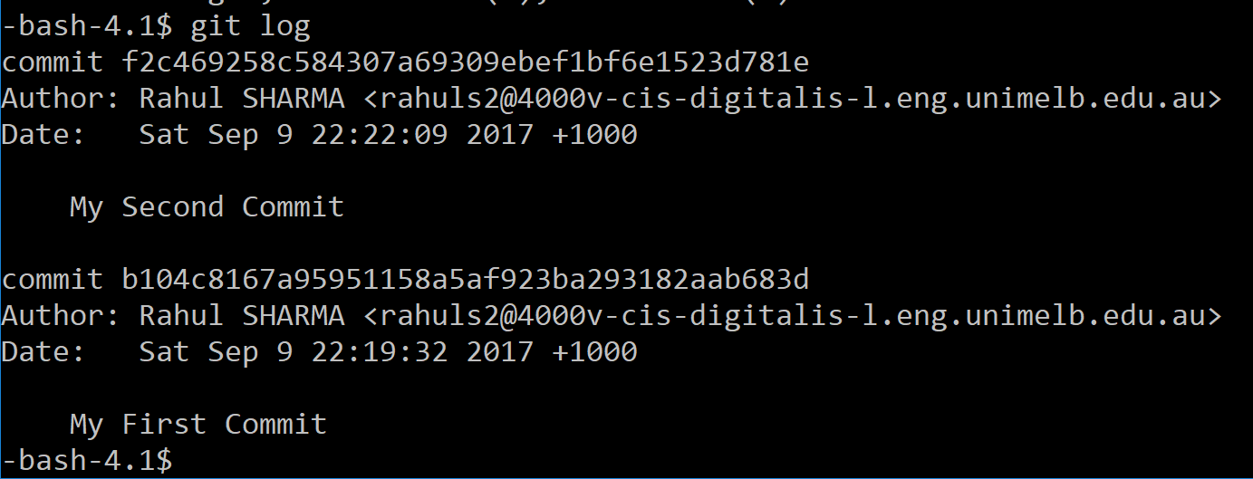
git log
View all your commits and save the hash of the commits to notepad or somewhere.
Type: git checkout <hash of first commit>
vim testOne.txt
Modify the text (in insertion mode ‘i’) then press Esc.
Type :wq and press Enter.

Slide 23
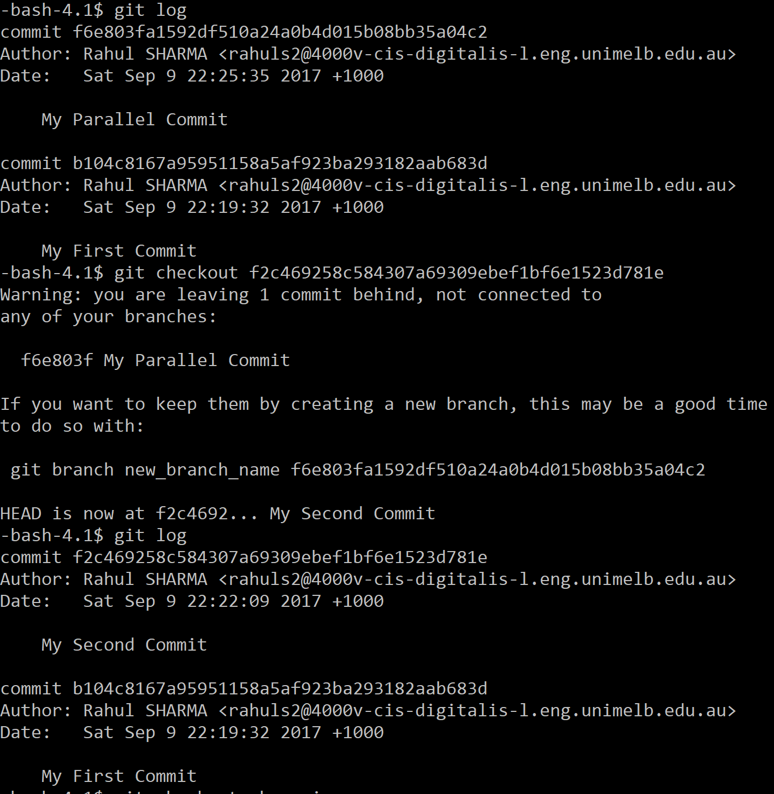
git add .
git status
git commit –m “My Parallel Commit”
git log
Where is My second commit ?
Type:
git checkout <second commit hash>
git log

Slide 24
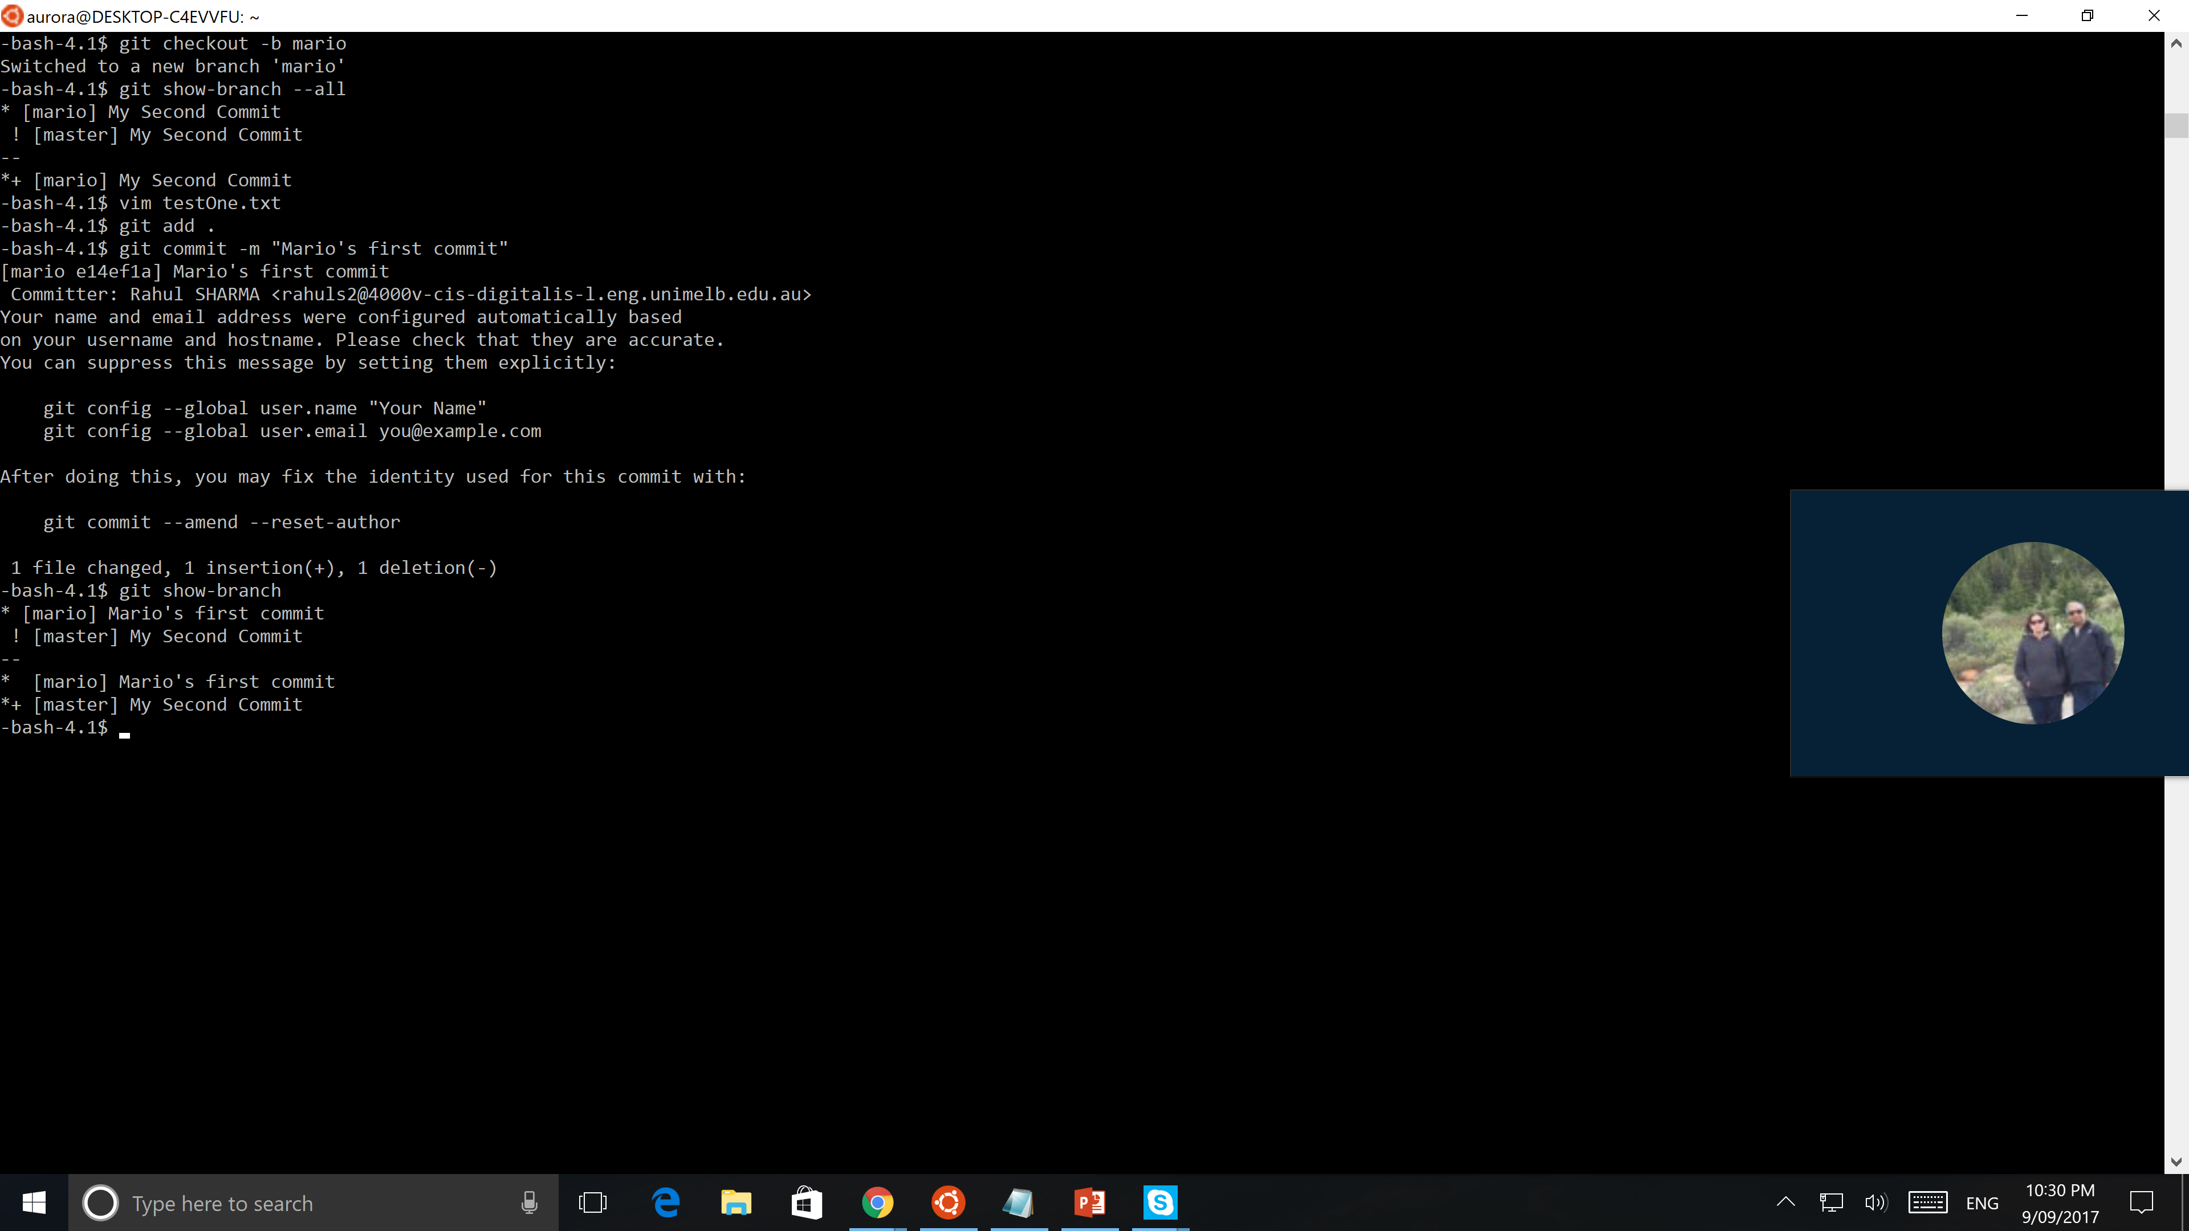
To create a branch, type:
git checkout –b <name of your branch>
git show-branch --all
vim testOne.txt
git add .
git commit –m “Mario’s first commit”
git show-branch.

Slide 25
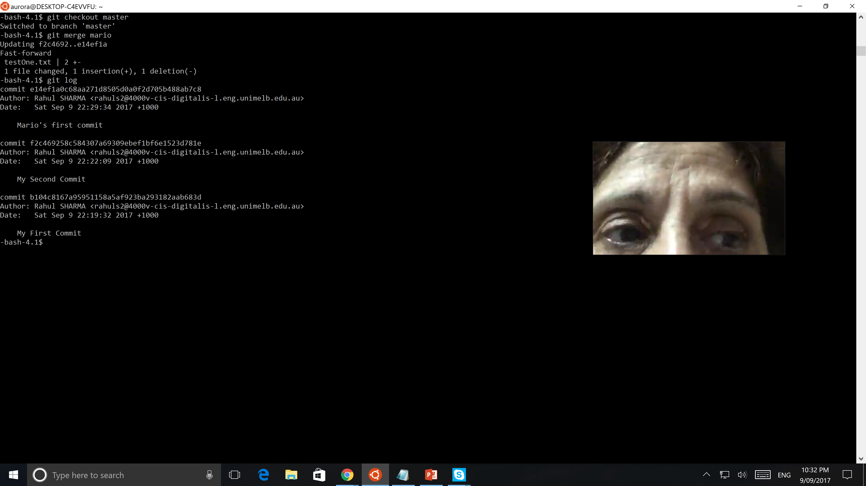
Usually we pass our code through multiple stages like test environments and so on using tools or defined processes before committing our code into the master branch which hosts our production level code. (for Ex - https://cucumber.io/)
Here, we assume that everything is alright and we can commit to the master branch directly. Type:
git checkout master
git merge Mario
git log

Slide 26
Thank you
References:
https://www.atlassian.com/git/tutorials
https://git-scm.com/
https://try.github.io/
http://thehackernews.com/2015/03/github-hit-by-massive-ddos-attack-from_27.html

